Slide 1
HOSPITAL MANAGEMENT DATABASE
CONTRIBUTERS:-
K.Yogesh
G.Pavan Kumar
A.Chandrakanth

Slide 2
What is sql?
SQL stands for Structured Query Language
SQL lets you access and manipulation databases
SQL becomes a standard of the American National Standards Institute(ANSI) in 1986 ,and of the International Organisation for Standardization(ISO) in 1987
SQL is the standardized programming language that is used to manage relational database and perform various operations on the data in them

Slide 3
COMMAN WE USED:
The CREATE TABLE command creates a new table in the database.The following SQL creates a table called “patients_information” that contains seven columns:UniqueID,Pname,Psurname,Dateofbirth,SSN,InsuranceNumber,Age:
CREATE TABLE Patients_information (
UniqueID INTEGER PRIMARY KEY,
PName TEXT NOT NULL,
PSurname TEXT NOT NULL,
Dateofbirth TEXT NOT NULL,
SSN TEXT NOT NULL,
InsuranceNumber TEXT NOT NULL,
Age TEXT NOT NULL
);

Slide 4
INSERT INTO STATEMENT
INSERT INTO SYNTAX
It is possible to write the INSERT INTO statement in two ways
1) Specify both the column names and the values to be inserted:
2) If you are adding values for all the columns of the table,you do not need to specify the column names in the SQL query
We used second way in this
Eg:-
INSERT INTO patients_information VALUES (1,'Avinash','Boddu','16-04-2001','345691246','86635573832','22');

Slide 5
JOIN OPERATIONS IN SQL
Different Types of SQL JOINs:
Here are the different types of the JOINs in SQL:
(INNER) JOIN: Returns records that have matching values in both tables
LEFT (OUTER) JOIN: Returns all records from the left table, and the matched records from the right table
RIGHT (OUTER) JOIN: Returns all records from the right table, and the matched records from the left table
FULL (OUTER) JOIN: Returns all records when there is a match in either left or right table

Slide 6
ABOUT PROJECT
We have created hospital management database.In which we have created four tables.It explains about the patients ,doctors information,rooms and patients treatment and doctors consultation.
With this we can clearly say that about the patients condtions and doctors treatment using the created tables.

Slide 7
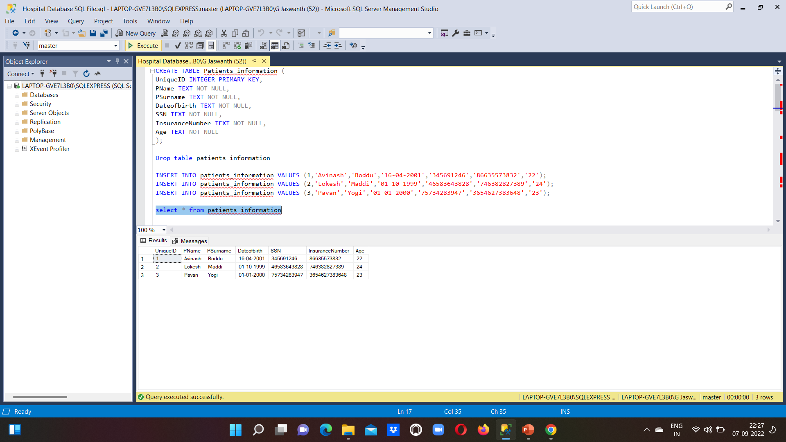

Slide 8
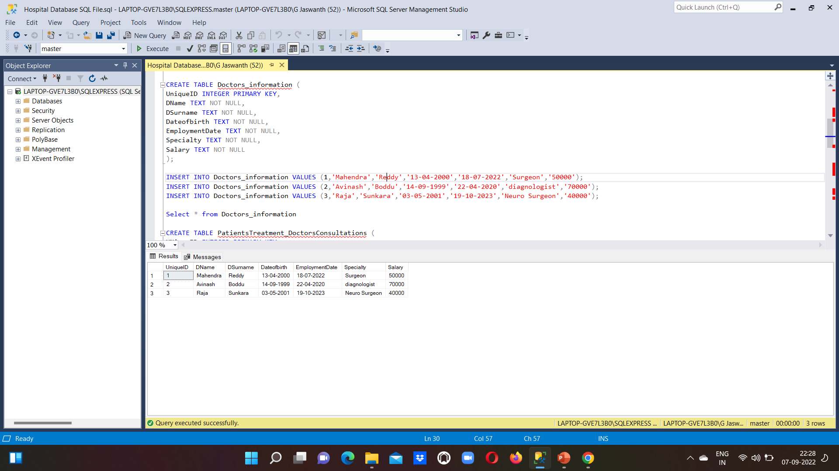

Slide 9
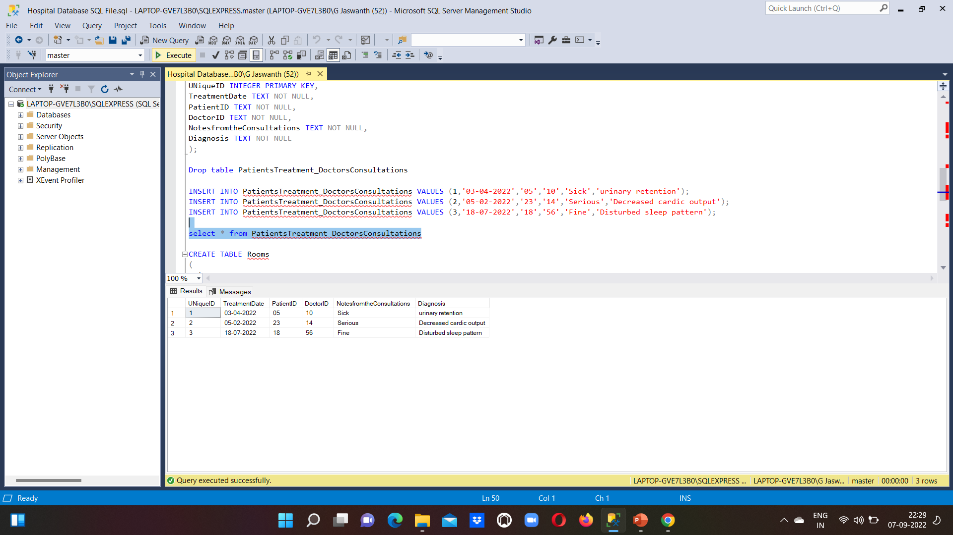

Slide 10
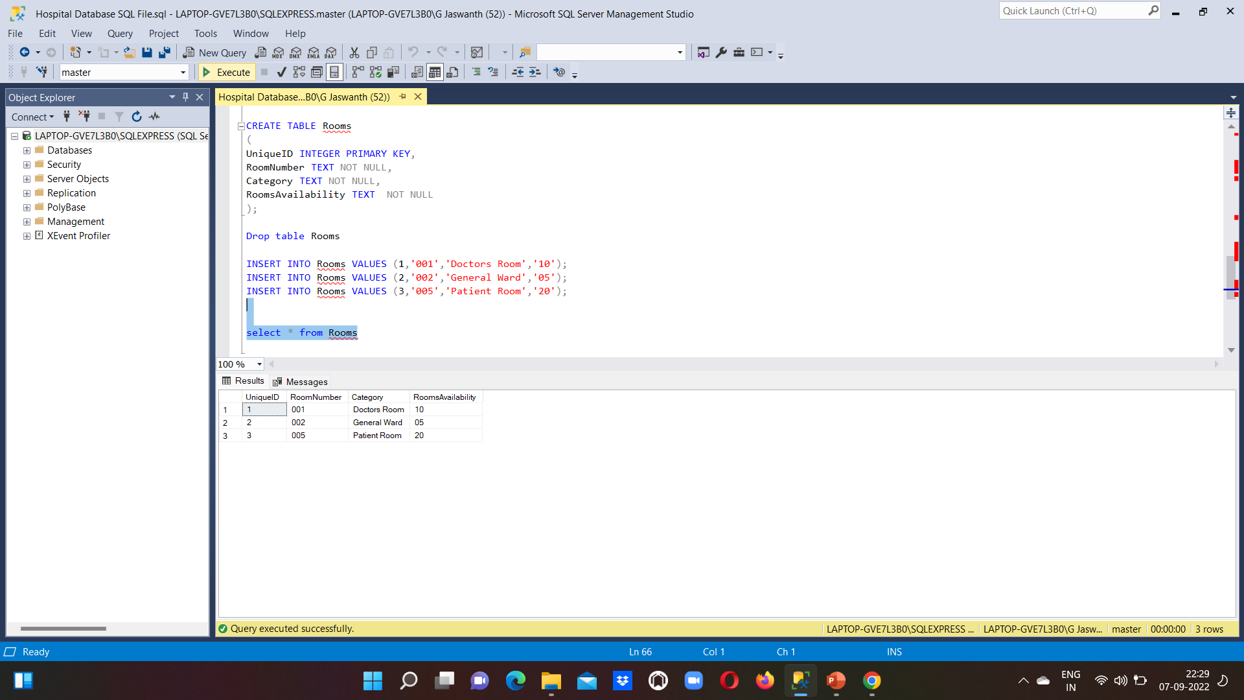

Slide 11
THANK YOU

